Slide 1
IN4331 Project Presentation
Koen Boes and Zmitser Zhaleznichenka

Slide 2
Outline
Assignment 1
  Structure
  Challenges
  Demo
Assignment 2
  Hadoop & Pig Latin
  Demo
Summary

Slide 3
Assignment 1
Project structure
CSS files
images
JavaScript (eXist REST API)
PHP
XSLT
index.html

Slide 4
Assignment 1
Challenges
Cross-domain Networking (AJAX)
Proxy
Quotes
No System Calls (JavaScript)
XMLHTTPRequest returns only XML or Text
Need to return URL to PDF

Slide 5
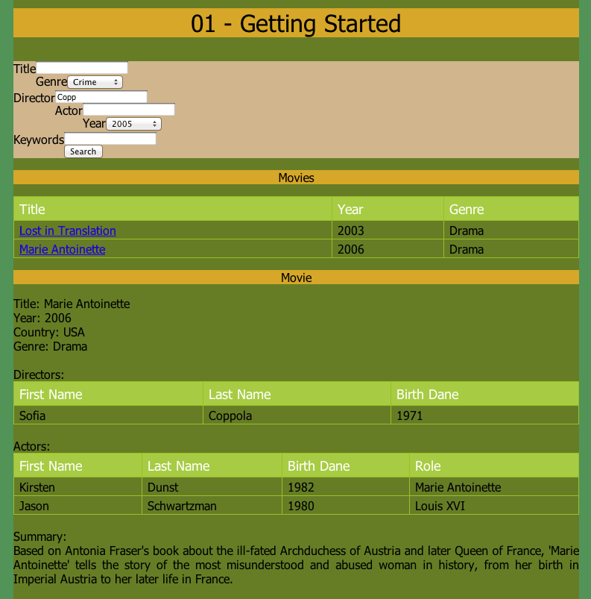
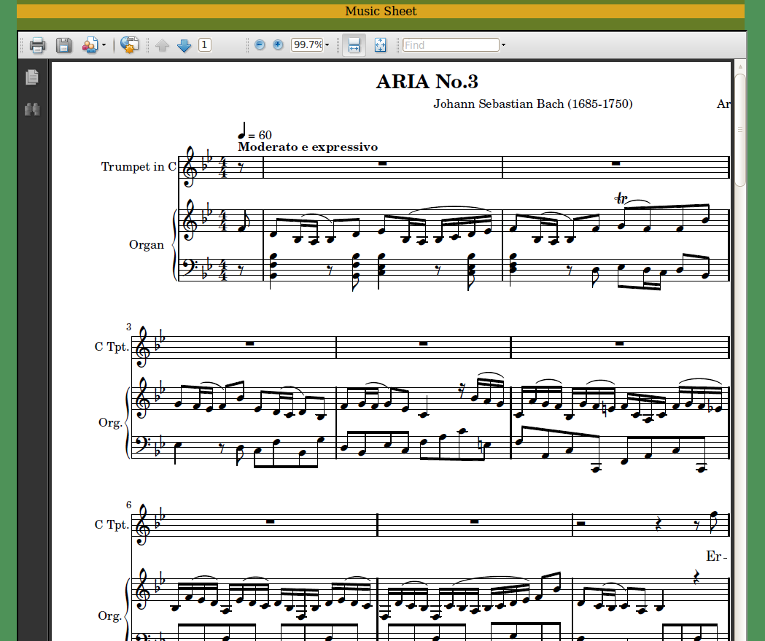
Assignment 1
Demo

Slide 6
Assignment 2
Hadoop & PIG Latin
XMLInputFormat to parse movies.xml
To emit multiple classes of values at once, distinct keys are used
MultipleOutputs interface to output to different files
Project 4: different reducers, single mapper
Normalisation, inverted indexing, TF-IDF

Slide 7

Assignment 2
Demo

Slide 8
Summary
Some problems were encountered
Projects were successfully completed
Projects have clear and understandable structure

